Slide 1

Event loop deep dive
Tamar Twena-Stern

Slide 2
Agenda
Traditional approach – Blocking I/O
The opposite – Non blocking I/O
The event loop in a nutshell
Event loop architecture and different components
What actually happening on the operating system ?
The different phases of the event loop
Why Node.js scales well

Slide 3
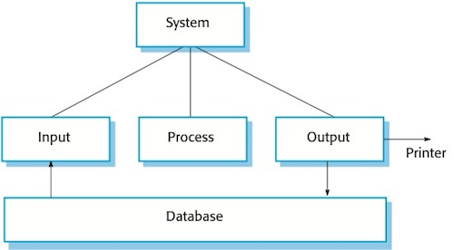
What is an I/O operation ?

Slide 4
Traditional Approach – Blocking I/O
Simple approach : wait until the I/O operation will complete
Block the program until I/O returns and leave the system idle.

Slide 5
Traditional Approach
thread
request
client
Server
request
thread
request
thread

Slide 6
Problems
The system allocates CPU and memory resources for every new thread
When the system is stressed – overhead of thread scheduling and context switching
The system waste resources for allocating threads instead of doing actual work

Slide 7
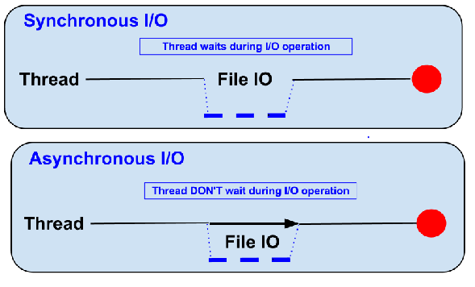
The opposite – Non Blocking I/O

Slide 8
Node.js – Non Blocking I/O
The Non Blocking I/O approach existed in JavaScript way back
JavaScript with it’s event loop model executed other events while waiting for I/O operations
In 2009 Ryan Dahl ran the JavaScript event loop on server – Node.js was born

Slide 9
Node.js Event Loop In A Nutshell

Slide 10
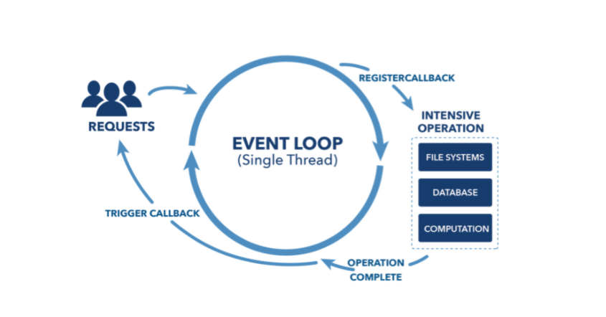
Event Loop in a nutshell

Slide 11
Event loop in a nutshell
What enables Node.js to perform non blocking I/O
Offloading I/O operations to system kernel whenever possible
Kernel informs Node.js that operation completed, callback queued in appropriate queue

Slide 12
Event loop architecture and different components

Slide 13
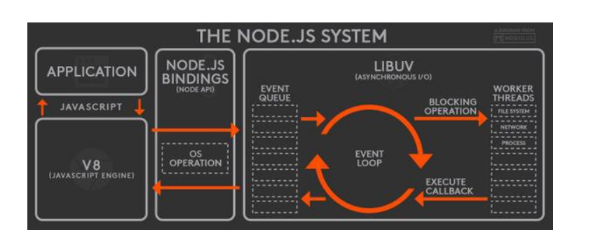
Node.js Architecture – High Level

Slide 14
Not Really Single Threaded
The Node.js system is not really single threaded after all
The event loop does run on a single thread
According to the diagram , we see that we have several threaded :
Event Loop
The workers thread pool

Slide 15
Event loop thread
Event loop runs on single thread
Each new request register a synchronous callback which executes almost immediately
Execute JavaScript callbacks
Offloads I/O operations to worker thread pool.
Handle callbacks for asynchronous I/O operations that finished from multiple requests.

Slide 16
Workers thread pool
Thread pool to perform heavy operations
I/O
CPU intensive operations
Bounded by fixed capacity
Implemented with libUV
A node module can submit a task to libUV API with C++ add-on

Slide 17
Modules who use worker pool
I/O-intensive
DNS:
dns.lookup(), dns.lookupService()
File System: All file system APIs except
fs.FSWatcher()
explicitly synchronous operations.
CPU-intensive
Crypto:
crypto.pbkdf2()
crypto.randomBytes()
crypto.randomFill()

Slide 18
How Most Node Modules Submit A Request To The Worker Pool
To work with the worker pool – most modules use a set of ‘basic’ modules that work with the event loop
Examples in the previous slide :
Fs
Dns
Crypto
And more
There is a possibility to submit a task to libUV using c++ add-on
Few modules work in that method

Slide 19
What happening on the operating system level?

Slide 20
Event loop – What the operation system do ?
Does not maintain a queue!
Monitor collection of file descriptors
File descriptor ready
Signals operating system
Notifies event loop
Translates and invoke callback

Slide 21
Worker Thread Pool implementation
Maintain a queue of tasks
Each thread pops a task from the queue
When finished – raise event to event loop
Thread pops task
Execute the task
Raise event when done

Slide 22

Libuv in a nutshell :
Multi platform C library
Provides support for async I/O based on event loop
Supports :
Epoll (Linux)
Kqueue (OSX)
Windows IOCP
Solaris event ports

Slide 23
The order of operations in the event loop

Slide 24
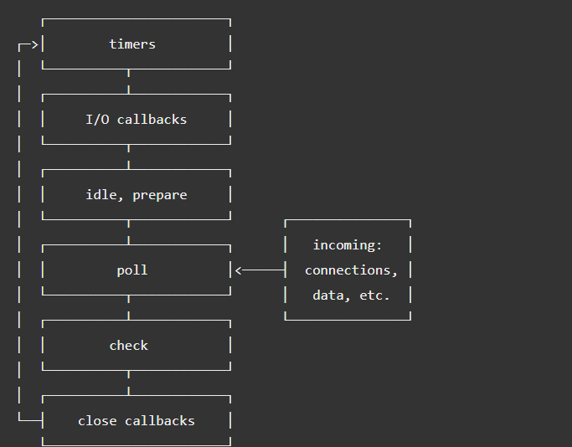
Event Loop Phases Overview

Slide 25
Event Loop Phases Overview
Timers – Execution of callbacks scheduled by setInterval and setTimeout
I/O callbacks – all callbacks except : timers, setImmediate, close callbaks
Idle , prepare – for internal use only.
Poll – Poll new I/O events, Node.js will block here on demand
Check – invoke callbacks scheduled by setImmediate
Close – callbacks scheduled by close events

Slide 26
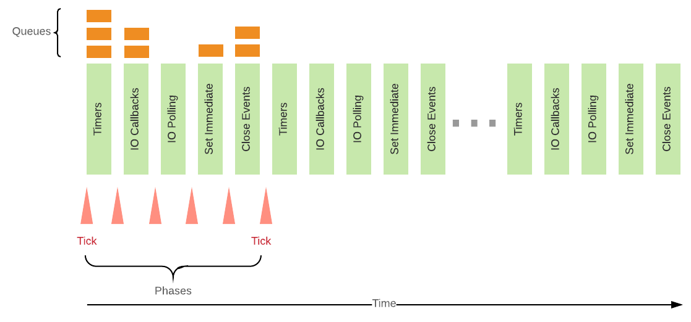
Phase General Mechanism

Slide 27
Timers Phase
setTimeout, setInterval
Timer’s callback will run as soon as they can be scheduled after the threshold
Timer’s callback scheduling controlled by the “poll” phase

Slide 28

I/O callbacks Phase
I/O operations
Specific system callback operations
For example : TCP socket errors

Slide 29
Poll Phase
Timers with threshold elapsed ?
Yes
No
Back to timers Phase
Poll Queue Empty ?
No
Yes
Execute Poll Queue Callbacks
Continue to “Check” phase

Slide 30
Check Phase and Close Phase
Check Phase - Execute callbacks for setImmediate timers
Close Phase – Handles an abruptly close of a socket or a handle

Slide 31
Process.nextTick()
Not part of the event loop
Runs before any I/O operation
Will be executed right away
Careful ! Starvation

Slide 32
The secret of Node Scalability

Slide 33
Why Node scales well ?
Small number of threads to handle many clients
One thread for event loop
Constant amount of threads in workers pool
Spend more time and memory working on clients actual work rather than paying space and time overheads for threads

Slide 34
Each Thread is critical !
Blocked Thread :
Long callback (event loop)
Long task (worker pool)
If thread is blocked - cannot handle requests from any other client.

Slide 35
Conclusion
Because Node has only a few threads, you must structure your application to use them wisely.
Remember - Node is fast when the work associated with each client at any given time is "small".

Slide 36
Questions ?

